Slide 1
CSCI222 Assignment 1
Warehouse Management Tool

Slide 2
Table of Contents
Introduction/Overview
Informal Specifications Elicitation
UML/Class Diagram
General Use Cases
Login Use Case 1 / Activity Workflow
Stock Use Case 2 / Activity Workflow
Summary Use Case / Activity Workflow
Component Diagram
Gantt Chart/Project Timeline
Version Control Software
Summary

Slide 3
Introduction
Our requirements include
Include detailed functional and non-functional requirements for the new system
The data, which the system manages and interfaces to other systems
Interfaces and functionalities for different classes of users
Identify classes, their relationships, attributes and operations
Use Visual Paradigm tool to draw class/component diagram
Develop a use case diagram
Activity workflow

Slide 4
Our Vision
The general vision of the system key features is to allow the manager keep track of the warehouse stock in detail. Keeping track allows the manager to plan ahead and optimise the processes for major decision-making as the system can output a summary of how the warehouse is operating.

Slide 5
Overview of the System
Core Project’s Requirements
Record incoming and outgoing stock
Categorize the stock in relation to their type
Search and display available stock
Search and display stock in accordance to price range and quantity
Summary Report of incoming and outgoing stock
Data stored encryption
Login authentication encryption/decryption
Unsuccessful login – system locked
Provide stock item alerts for below threshold limit
Main Constraints
System to be implemented in C++ and to run on Linux OS
Simple textual “menu-select” style of user interface

Slide 6
Informal Specifications Elicitation
Functional Specifications
Track stock at the warehouse (both incoming and outgoing)
Categorize and search stock
Display stock (ascending and descending) according to price range/category
User Authentication System & Data Storage Encryption option
Stock item alerts (when stock goes below the limit)
Textual manual
Notes:
YTD

Slide 7
Informal Specifications Elicitation
Non-Functional Specifications
Interface: User friendly, and displays the information at a glance
Security Requirements
Encryption
Data Integrity
Lightweight
Periodic Data Backup
Robust System
Notes:
YTD

Slide 8
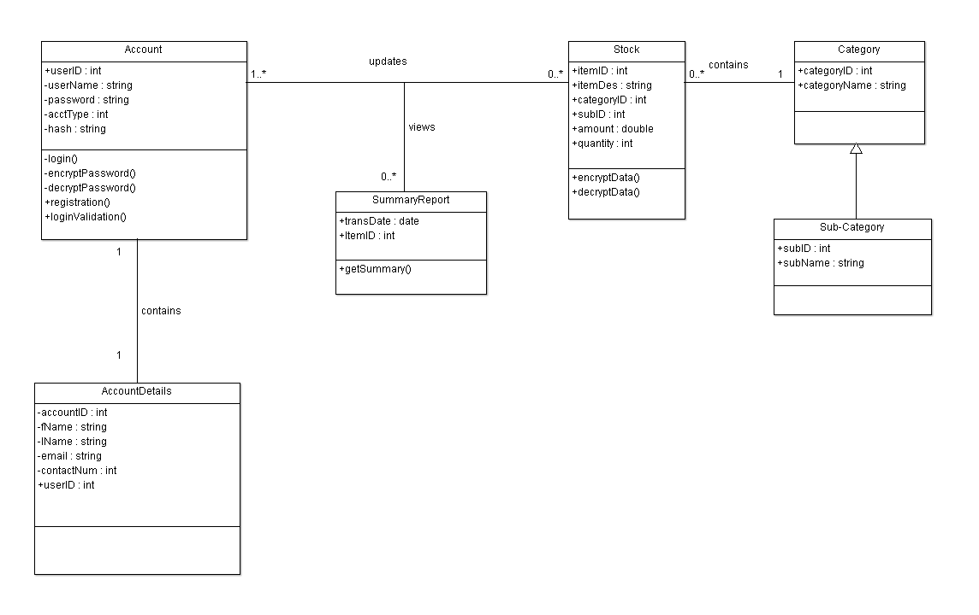
UML/Class Diagram: Iteration 1

Slide 9
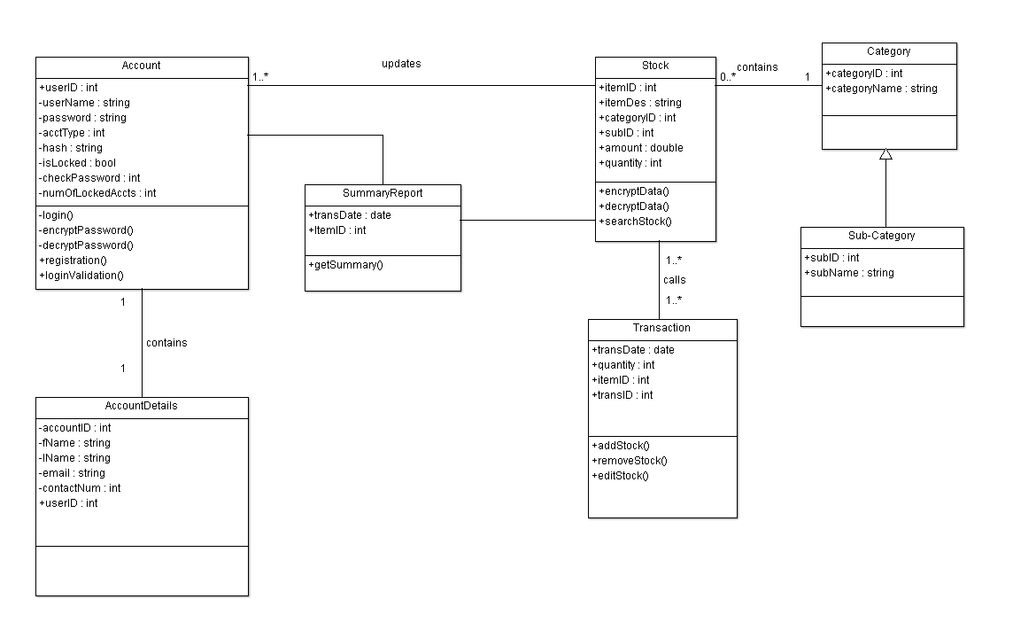
UML/Class Diagram: Iteration 2

Slide 10
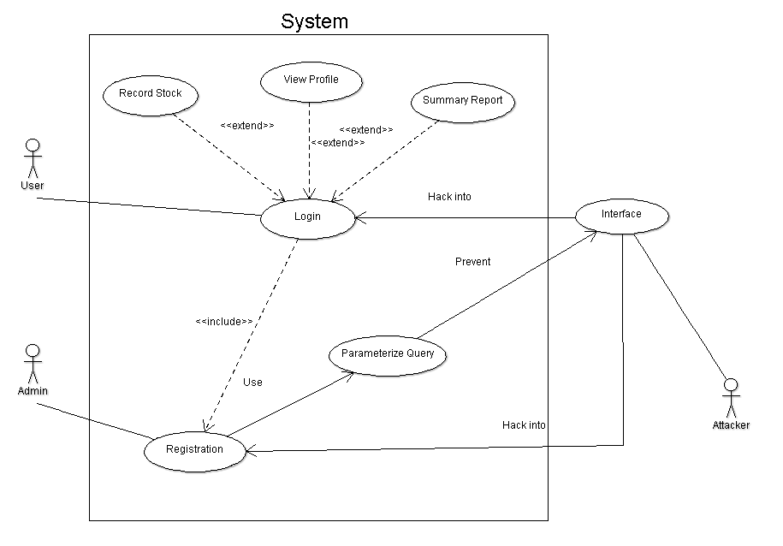
Use Case – General: Iteration 1

Slide 11
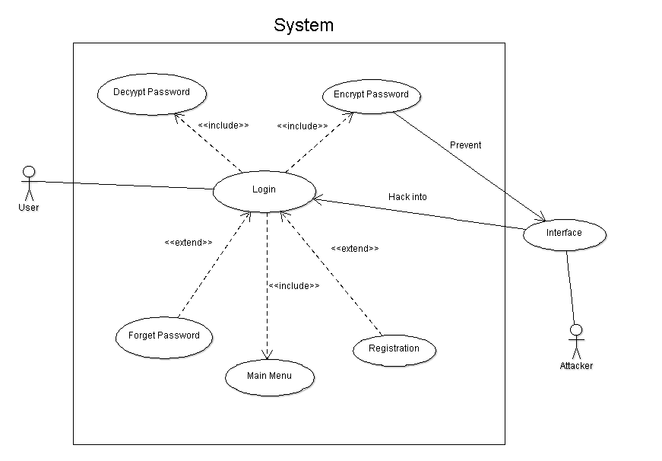
Use Case – Login: Iteration 1

Slide 12
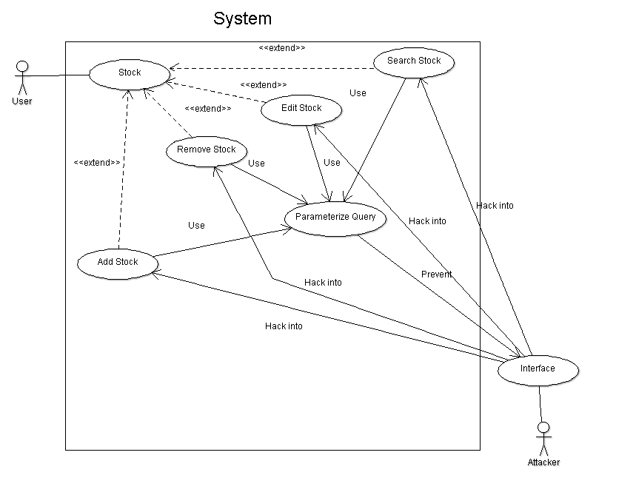
Use Case – Stock: Iteration 1

Slide 13
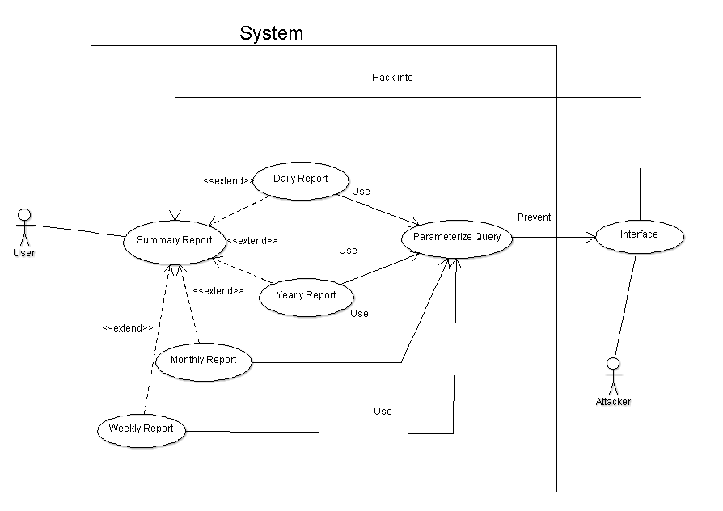
Use Case – Summary: Iteration 1

Slide 14
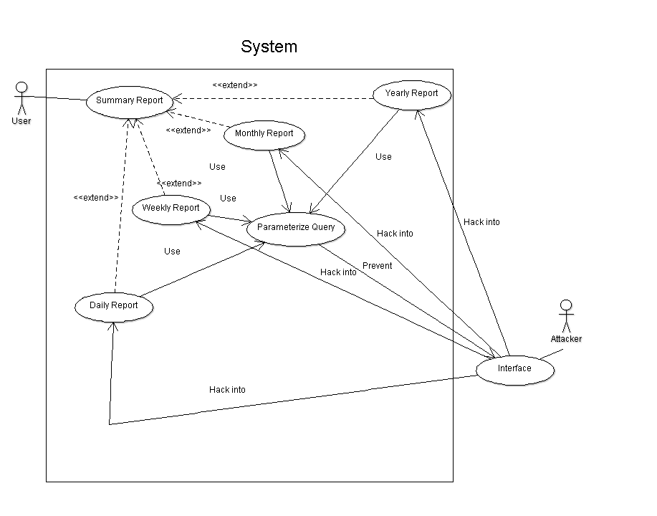
Use Case – Summary: Iteration 2

Slide 15
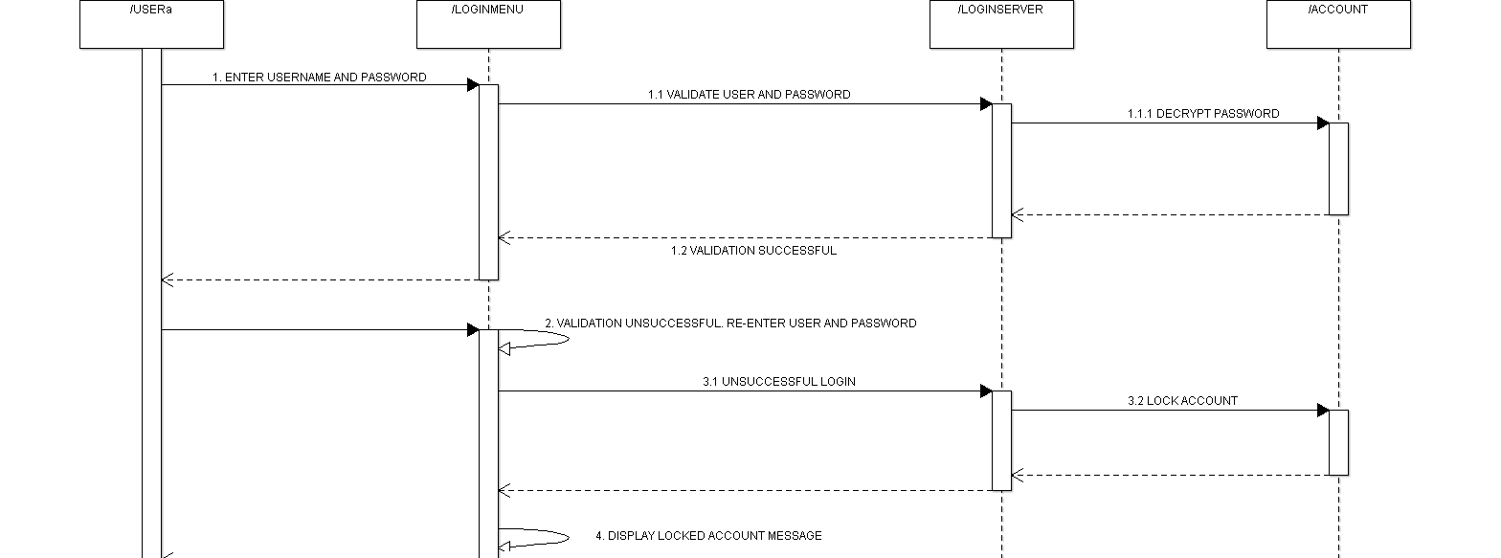
Activity Workflow – Login: Iteration 1

Slide 16
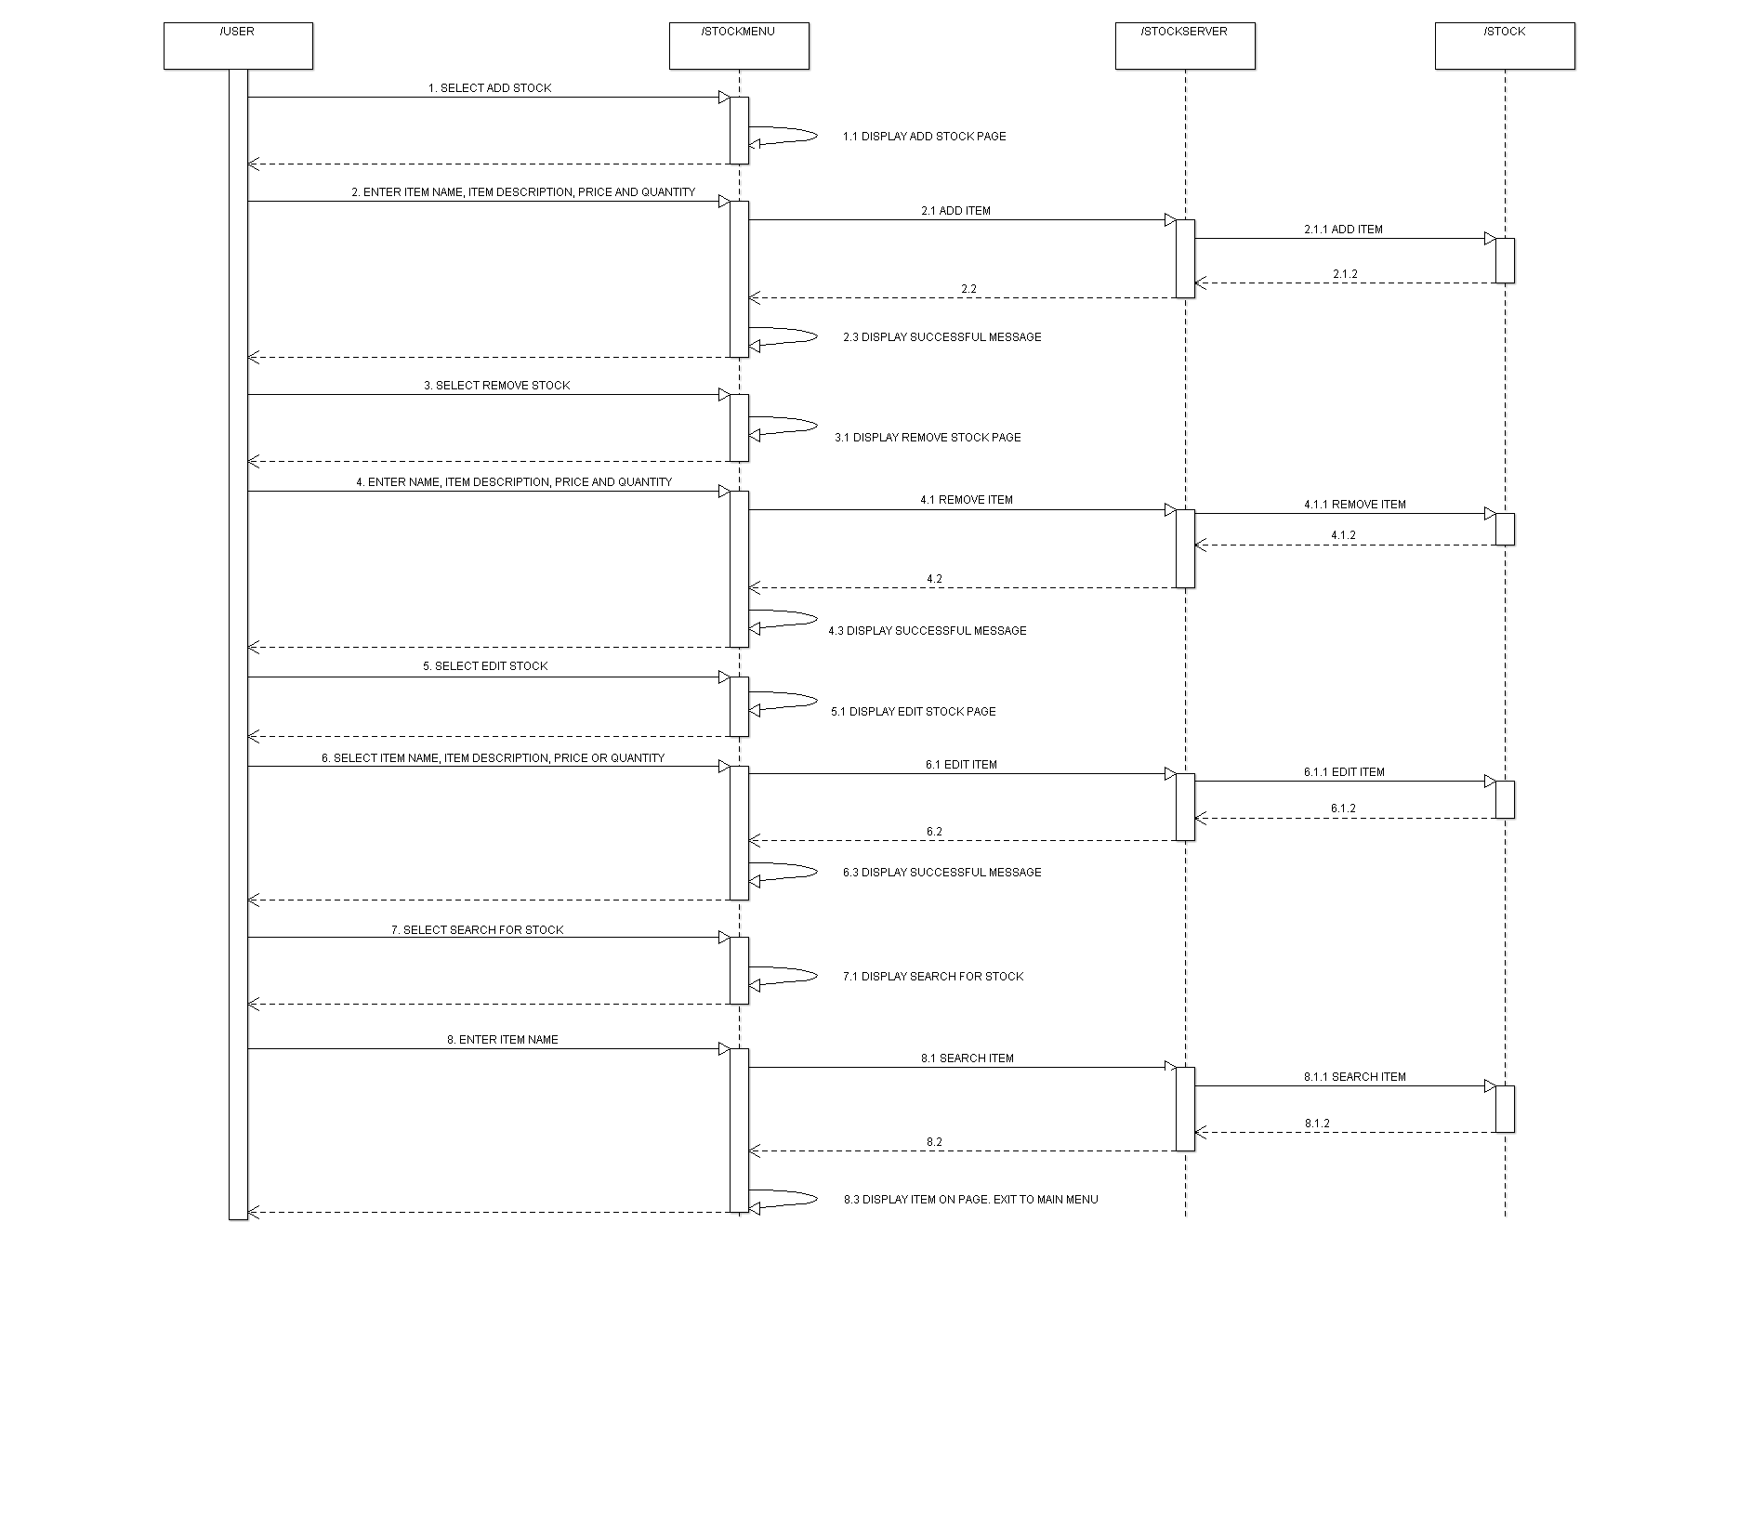
Activity Workflow – Stock: Iteration 1

Slide 17
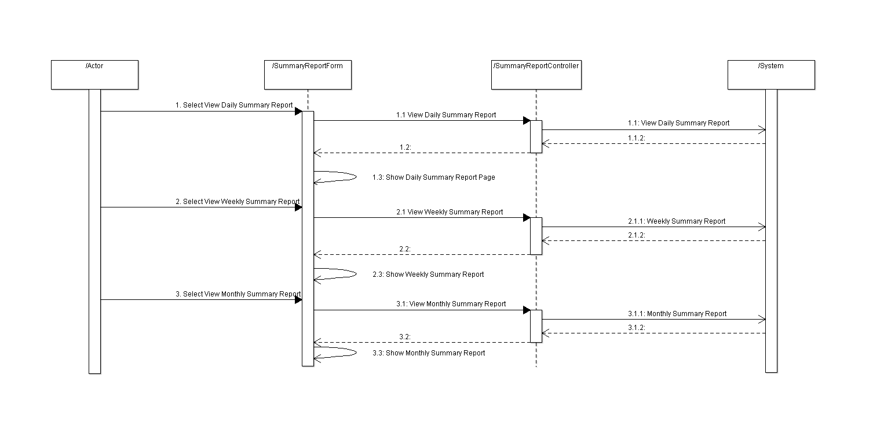
Activity Workflow – Summary Report: Iteration 1

Slide 18
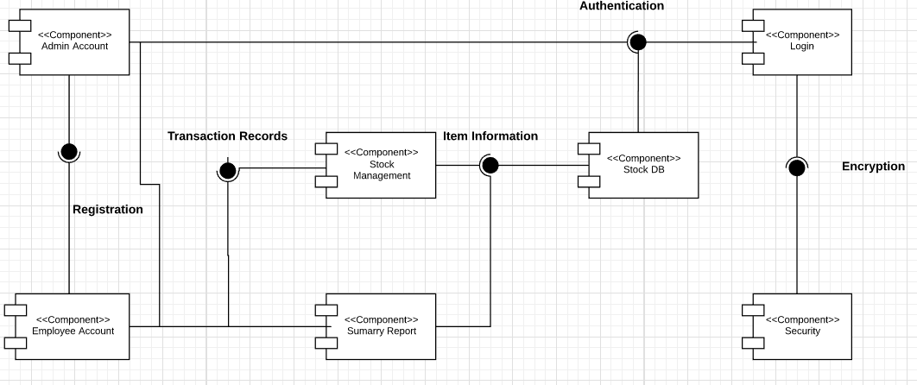
Component Diagram: Iteration 1

Slide 19
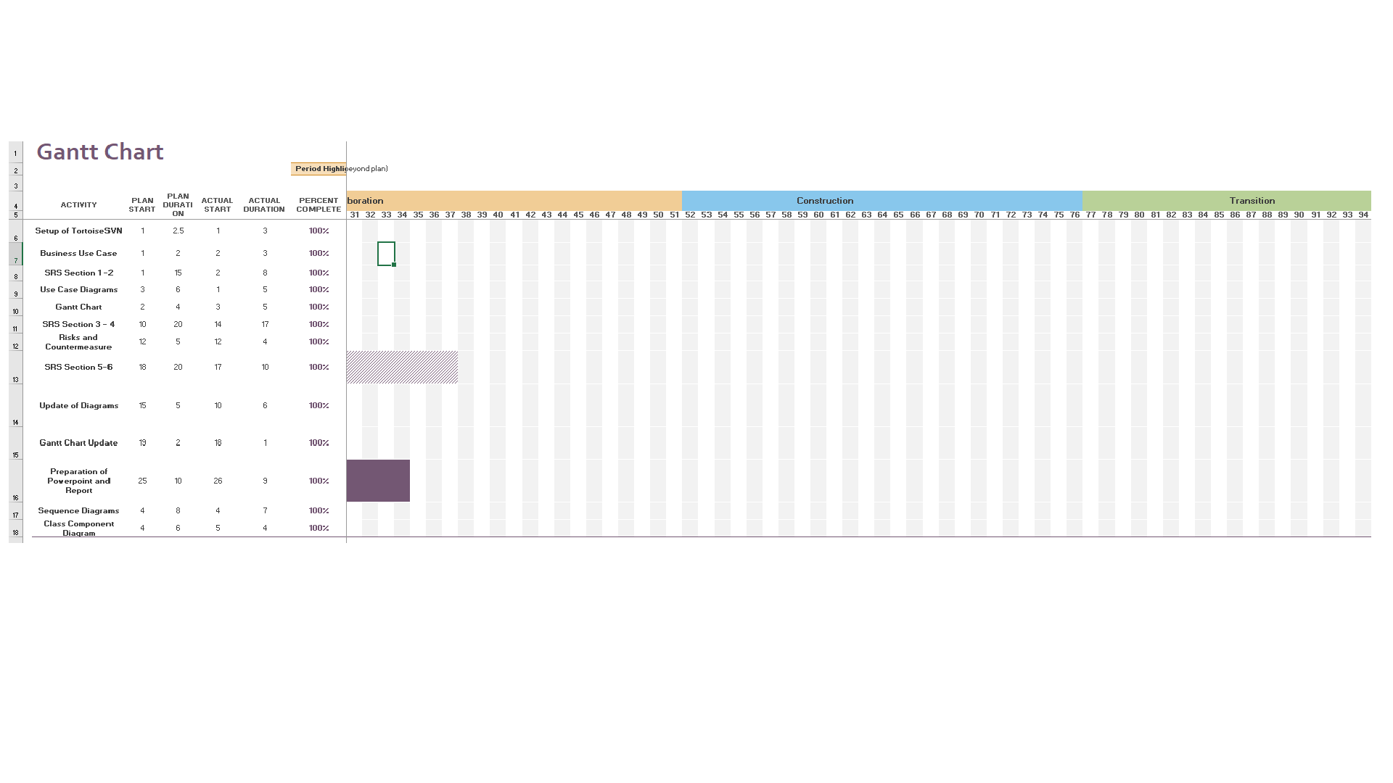
Gantt Chart/Project Timeline

Slide 20
Version Control Software
Add here

